Slide 1
硕士英语读写教程
43 元
所售教材价格均为正版折后价，不能开发票
售书地点：学园一246，售书时间： 2019年9月9日-9月20日工作日，上午9.00-11.30，下午1.30-4.30 （如无助教值班，请更改时间购买）；
因教材订购数量有限，请同学们尽早购买，售完为止；
按任课教师要求购买教材，避免不必要的退换
推荐使用支付宝付款，书，款当面点清。
听力教材可自行网上购买: 《朗文英语听说教程: Topic 1》

Slide 2
Vocabulary Testing
扫码下载app
用自己的手机号或者邮箱注册unipus账号
身份认证：输入学校名字，自己的学号，及密码123456，完成认证
开始考试
时间：40分钟
交卷后可立即看到成绩

Slide 3

Week 1
JINGYA LI

Slide 4
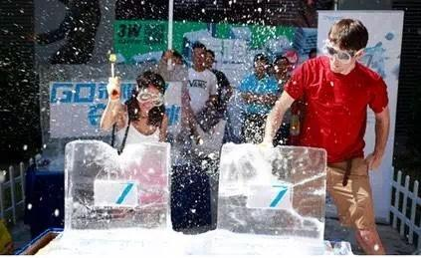
Icebreaker: prepare for grouping
Name tag (Chinese): bring it every time
Self-introduction
Name
School
Major
Notes:
One or two sentences
Whole class

Slide 5

Grouping
A group of 3-4 students
Similar majors
Interested in similar topics
Add in WeChat Group
Seat in a group

Slide 6


1
Grouping
2
Introduction
CONTENTS
3
Assessment
4
Paraphrasing

Slide 7

Classroom rules
Attendance (approval of leave required)
Participation in class (no hands up)
Questioning whenever needed in class (Sharing)
No teasing
Fair and equal
Notes:
The importance of sharing

Slide 8
Course Schedule
Unit 1: Week 4-6
Unit 2 Text B: Week 7
Unit 3: Week 8-10
Unit 4: Week 11-13
Unit 5: Week 14-16
Presentation: Week 17-18

Slide 9
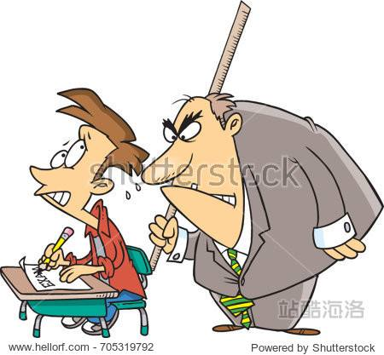
Assessment: Competitive
Attendance (5%)
Computer-based tests:
Vocabulary test (20%)
Listening test: unit 1-6 (15%)
Lesson preparation (group work) (5%)
Unit review (40%)
Final presentation (group work) (5%)
Final project (group work) (10%)
Bottom-out: every score counts

Slide 10

Plagiarism
Copying
Quoting verbatim
Paraphrasing
Using ideas
Cutting and pasting
Submitting someone else’s work
Colluding

Slide 11
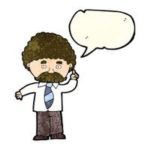
Lesson preparation
Presentation group 5 mins each person
Send me names of each group before this Friday
Individual score
Understanding of reading Text A
Main idea
Theme and structure
Theme—supporting ideas/evidence
Complex sentences you think are important to share
Language points (key words or phrases only)
Reading skills
What are the skills?
How and when to use it?
Examples in terms of your own subjects

Slide 12
Assessment for group work
Contribution
Come to an agreement within your group
All group members take the same responsibilities
Write down contribution statement at the end of each assignment
The deadline is the deadline, no extension allowed
Any comment or change after the submission of assignment will not be accepted

Slide 13
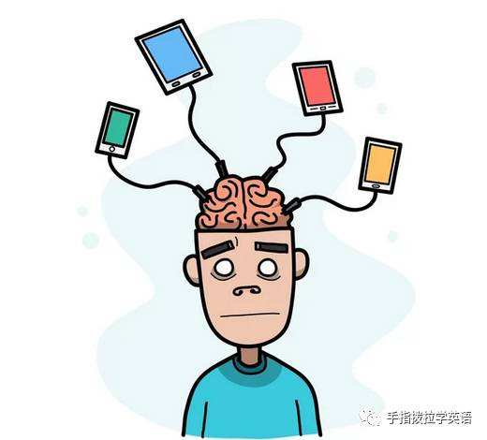
What is research?
We have a question or problem.
We want to answer or solve it.
Question or problem first!
How to find questions or problems?
Review the literature: know what other people have done
Academic skills: paraphrasing

Slide 14
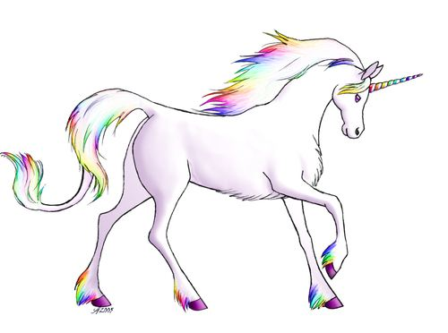
Game: group work
Define “unicorn” (5 mins)
An imaginary white creature like a horse with a single horn growing from the front of its head.
An imaginary animal that looks like a white horse and has a horn growing from its forehead.

